Slide 2
How Microsoft Finance uses BI Tools to Manage Spend part 1 of 2: Back End
THR2035
Jim Brown
Sr. Finance Manager
Lum Veselaj
Finance Director
Chris Hamill
Sr. Finance Manager

Slide 3
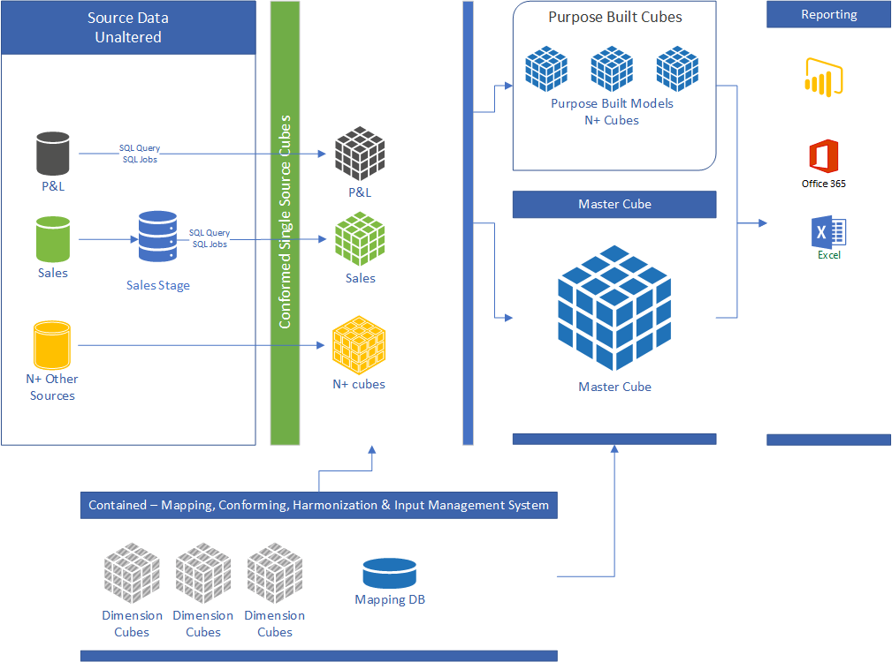
Infrastructure
Azure First Approach
Azure DB
Azure Analysis Services
Design Principles
Accuracy
Reliability
Performance

Slide 4
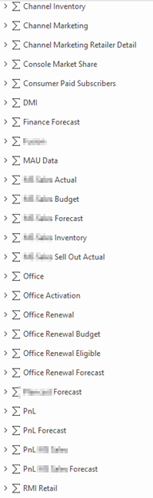
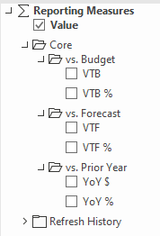
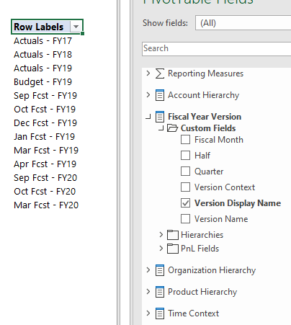
Simplified Measures
43 measures, each with 3-10 children
Related Data
Reliance on Cube Dimensions
Built-In Context

Slide 5
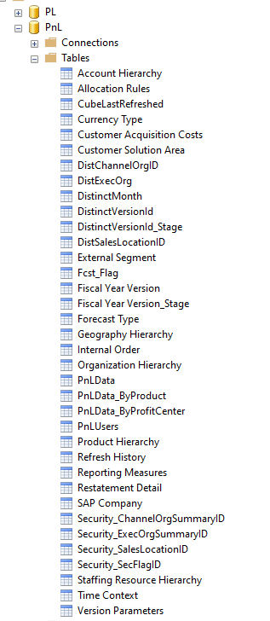
Multiple Cube Facts
Each fact provides a different level of granularity
Few measures, simplifies development
VAR byProd = SUM ( PnLData_ByProduct[Amount] )
VAR byPC = SUM ( PnLData_ByProfitCenter[Amount] )
VAR byTotal = SUM ( PnLData[Amount] )
VAR details = IF (
ISCROSSFILTERED ( 'Internal Order' ) = TRUE
|| ISCROSSFILTERED ( 'Allocation Rules' ) = TRUE
|| ISCROSSFILTERED ( 'SAP Company' ) = TRUE
|| ISCROSSFILTERED ( 'Restatement Detail' ) = TRUE,
TRUE,
FALSE
)
VAR Product = ISCROSSFILTERED ( 'Product Hierarchy' ) = TRUE () && ISCROSSFILTERED ( 'Organization Hierarchy' ) = FALSE
VAR PC = ISCROSSFILTERED ( 'Product Hierarchy' ) = FALSE () && ISCROSSFILTERED ( 'Organization Hierarchy' ) = TRUE
VAR PCandProduct = ISCROSSFILTERED ( 'Product Hierarchy' ) = TRUE () && ISCROSSFILTERED ( 'Organization Hierarchy' ) = TRUE
RETURN
SWITCH (
TRUE (),
details = TRUE (), byTotal,
details = FALSE ()
&& Product = TRUE (), byProd,
details = FALSE ()
&& pc = TRUE (), byPC,
details = FALSE ()
&& PCandProduct = TRUE (), byTotal,
byPC
)

Slide 6
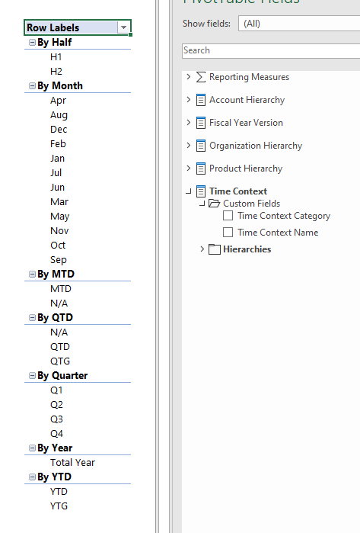
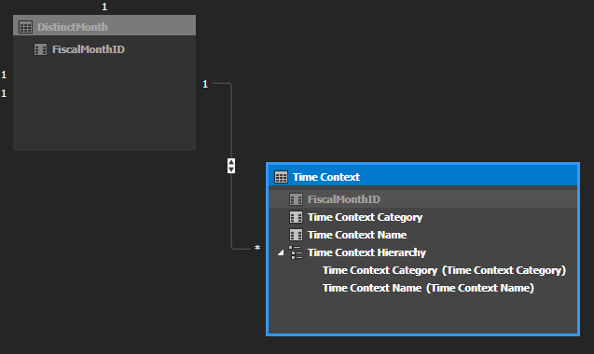
Context Related Time Dimension
Filtering By Various Time Cuts
Monthly
Quarterly
Yearly
Simplified Report/PowerBI Maintenance

Slide 7
PowerShell
Creating Cube Partitions
Selectively Refreshing Dimensions and Fact Partitions

Slide 8
https://github.com/purduepete/MBAS
Resources

Slide 9
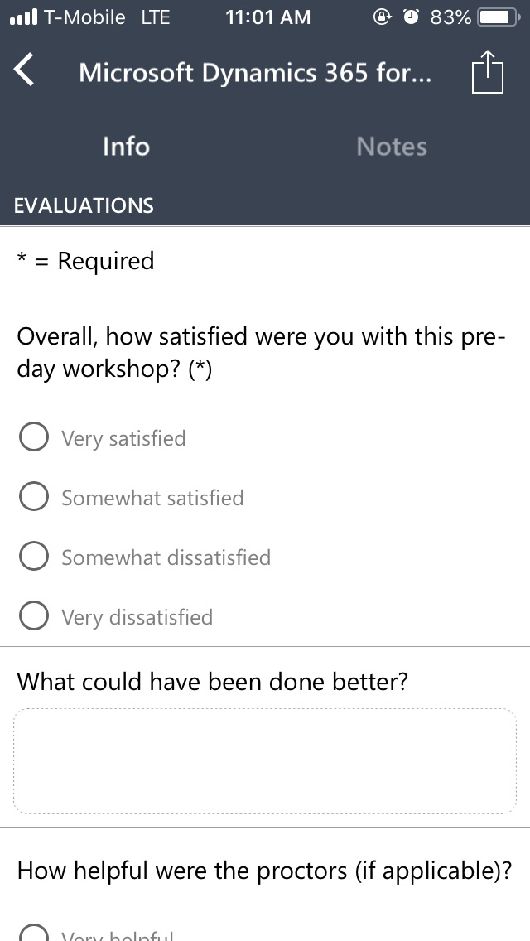
Evaluate this session
Complete your session and conference evaluations through the mobile app or https://aka.ms/MBASeventapp
Please select Microsoft Business Applications Summit from the menu of events and then log in with your registration credentials

